Slide 1
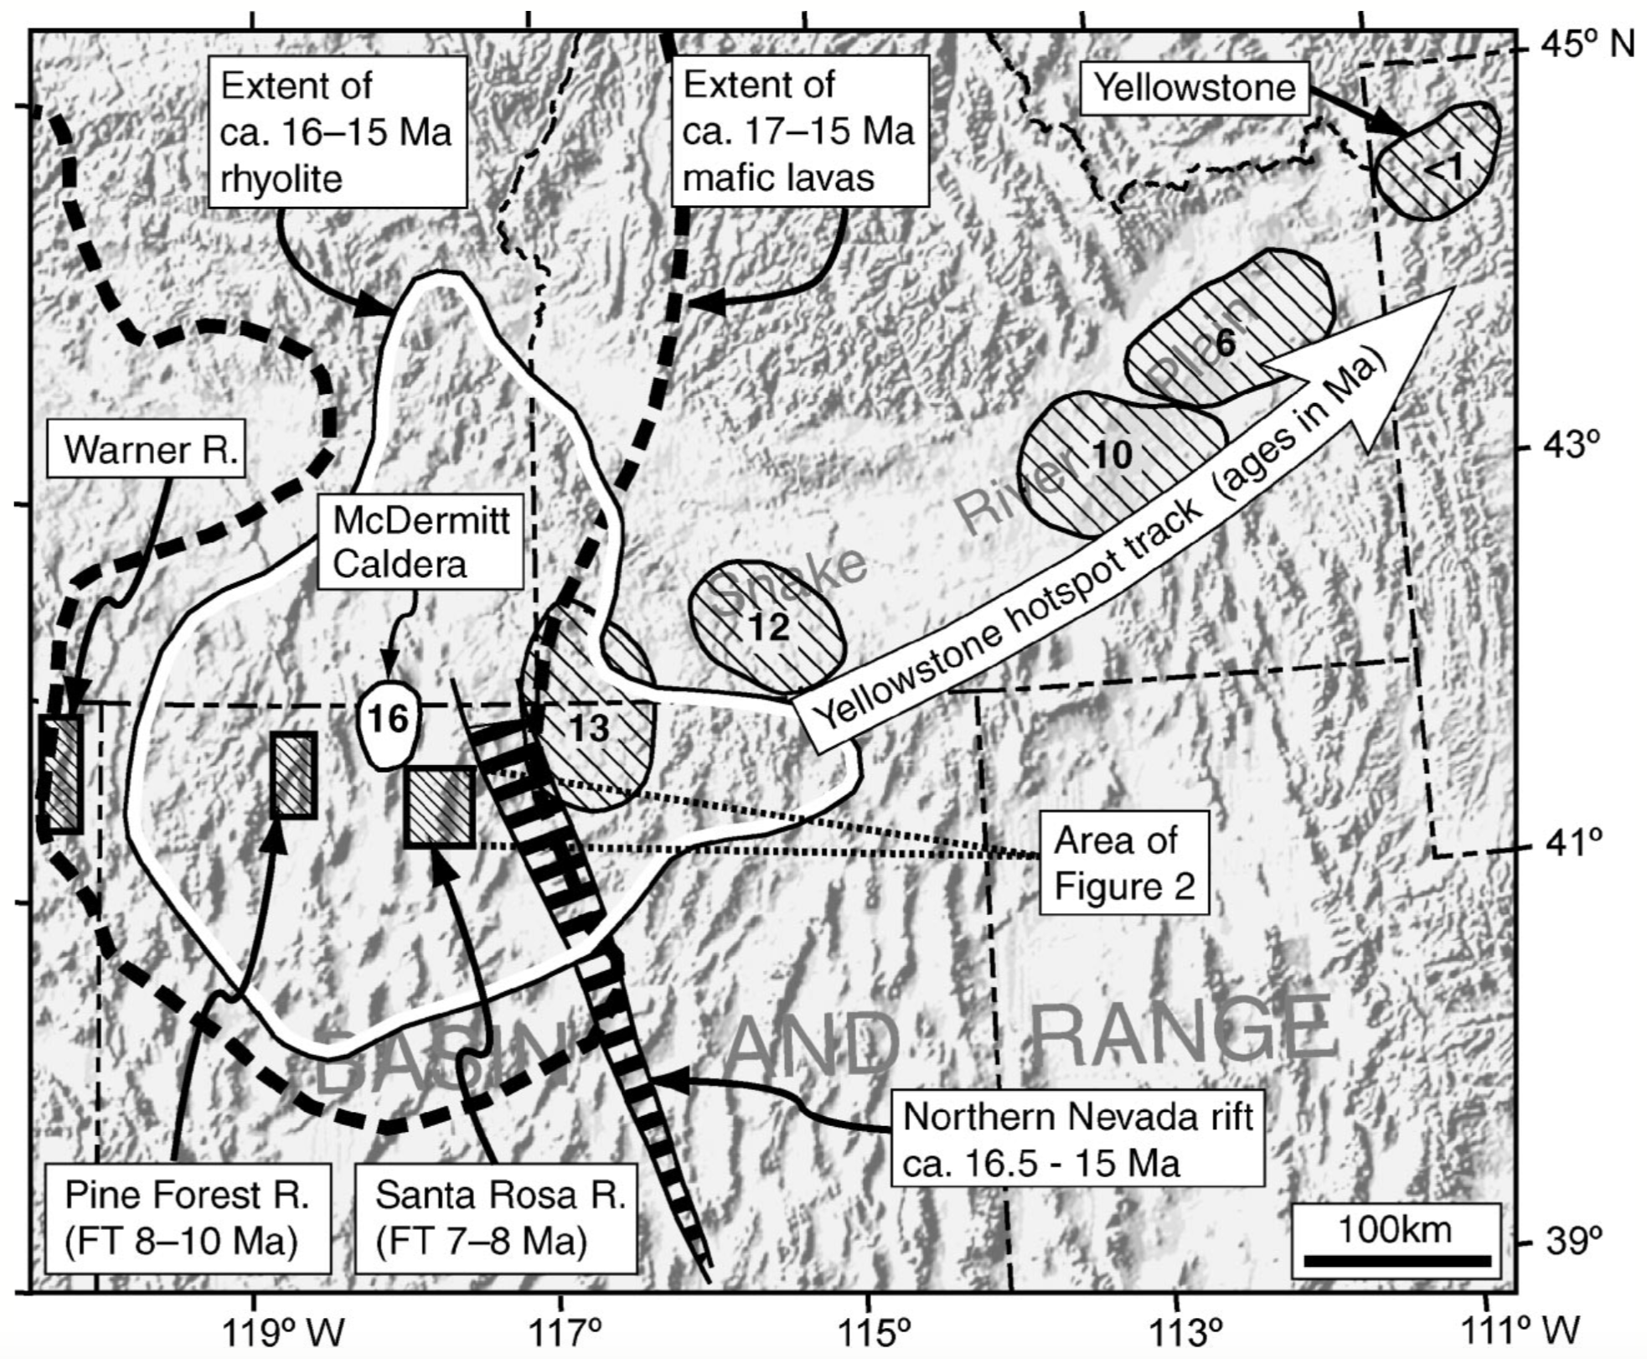
Diachroneity of Basin and Range extension and Yellowstone hotspot volcanism in northwestern Nevada
Colgan et al. 2004
Presented by Luke J. Schranz
Is the Yellowstone Hotspot responsible for the onset of Basin and Range extension?
Mantle plume origin for YHS is not universally accepted
Basin and Range Province has experienced episodic extension and volcanism since Eocene
Major Miocene extension is located much farther south of the YHS at 17Ma (McDermitt Caldera)

Slide 2
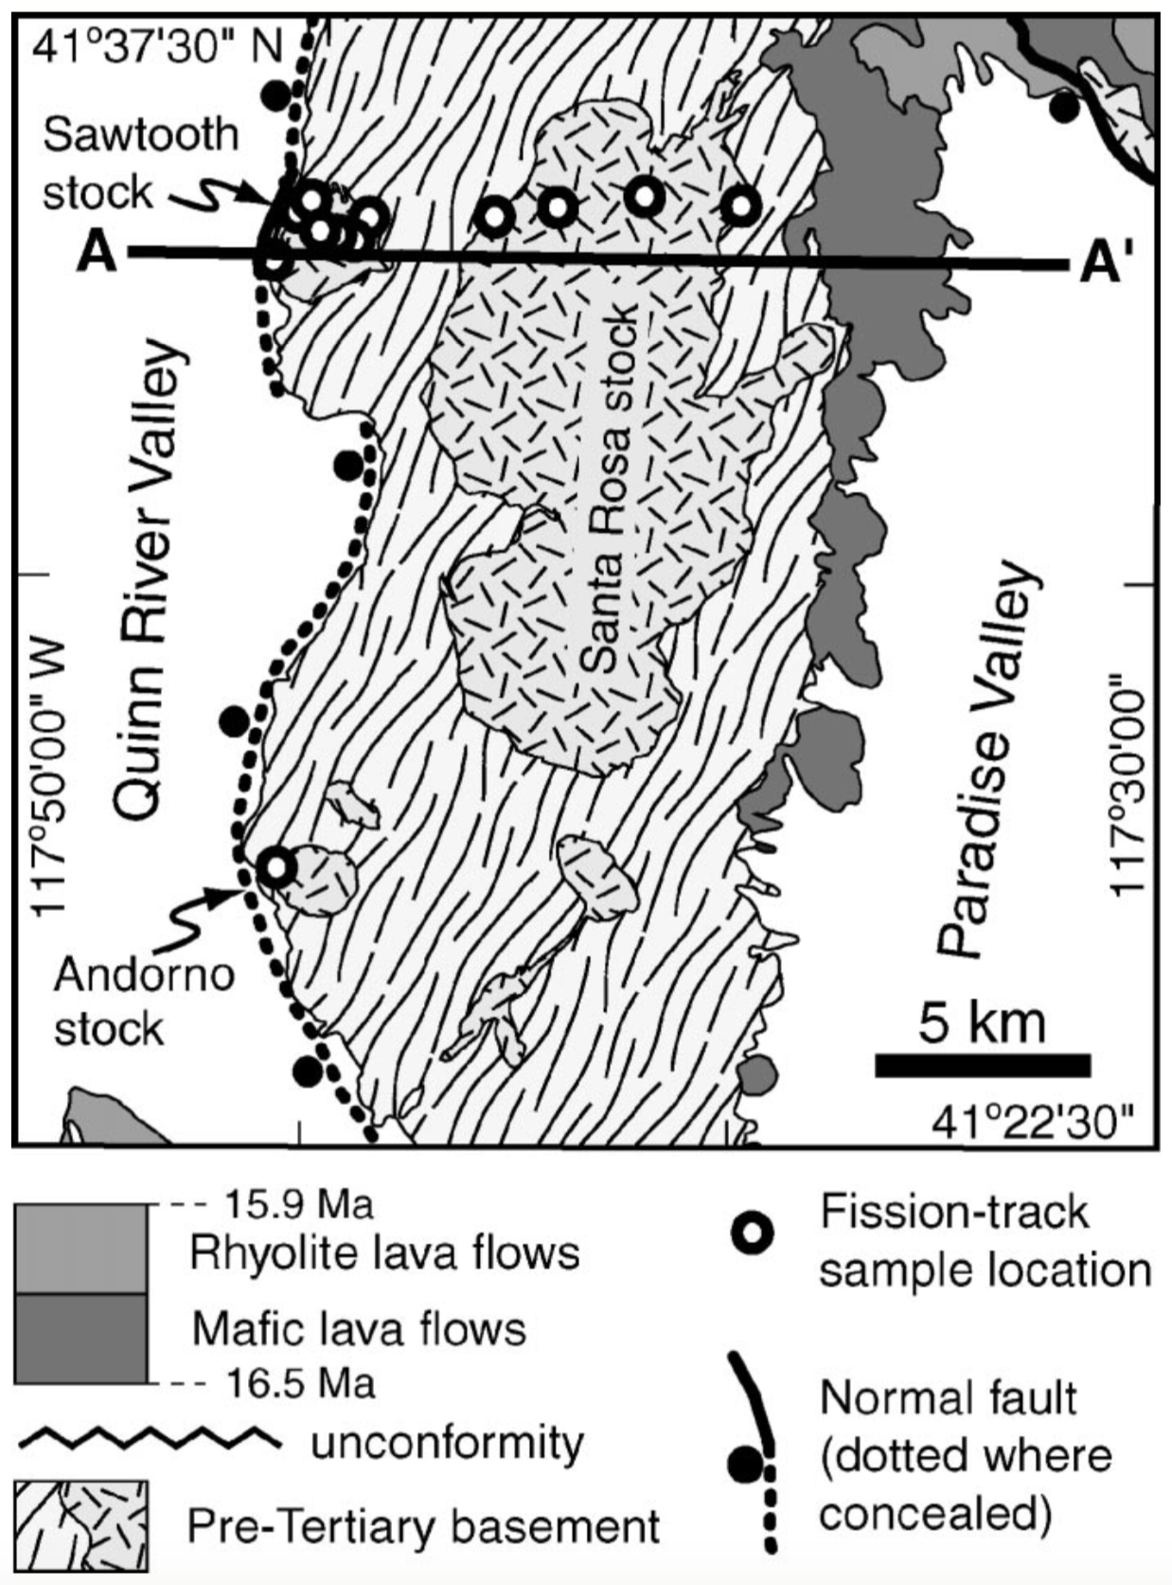

Slide 4
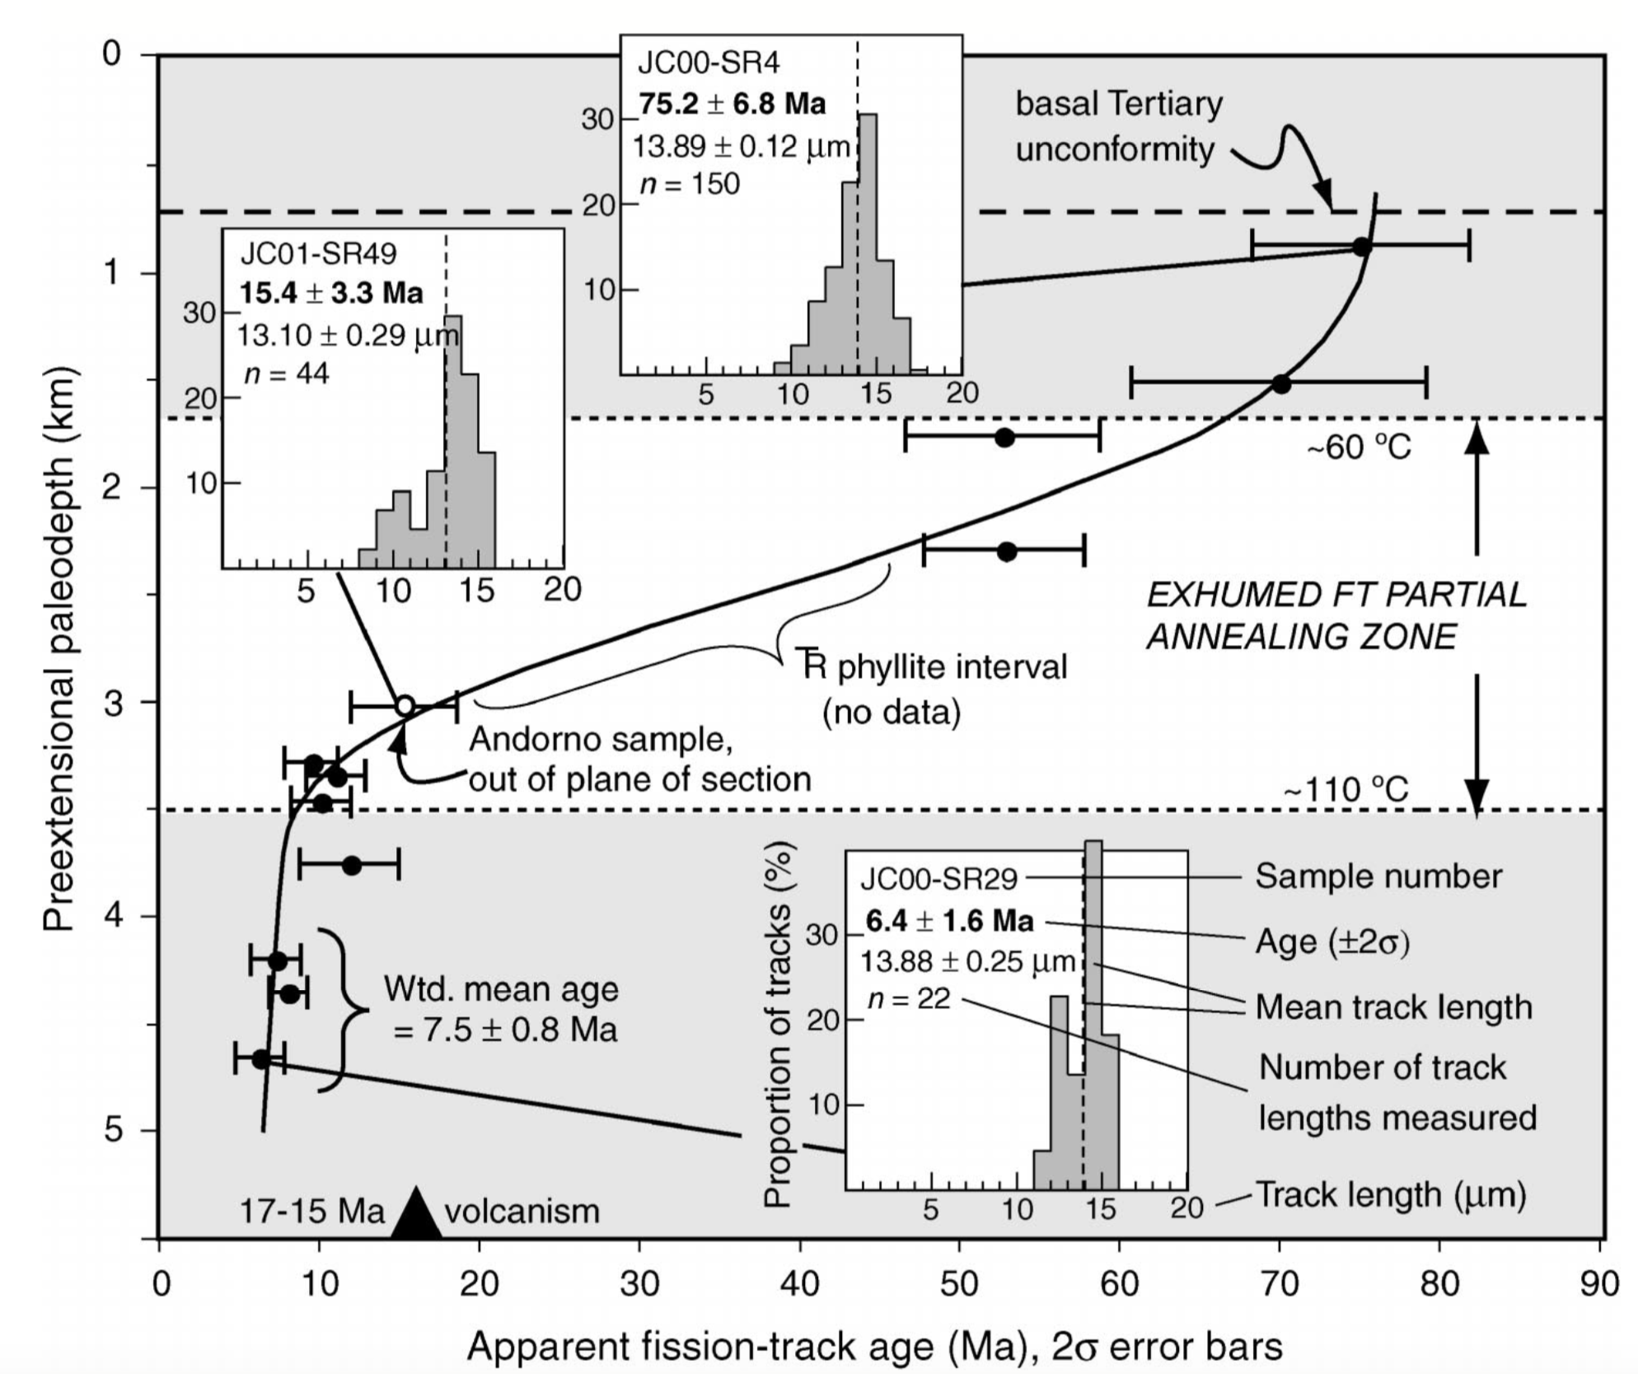

Slide 5
Conclusions and Questions
10 Ma onset of extension from apatite fission
Ongoing at 7.5 Ma
Distinctly younger than 17-15 Ma YHS development
Why does NW NV necessarily need to be effected by mid-miocene extension if YHS is “trigger”?

